Slide 1
Three-Tier Application Deployment on AWS EKS
Author: Rahul Shukla (DevOps | Kubernetes | AWS | GitOps)

Slide 2
Introduction
Objective: Deploy a scalable three-tier application (Frontend, Backend, Database) on Amazon EKS.
Key Components:
AWS EKS Cluster
AWS Load Balancer Controller
Kubernetes Manifests

Slide 3
Prerequisites
AWS Account (Free Tier recommended)
IAM User with AdministratorAccess
Ubuntu EC2 Instance (t2.medium, us-west-2)
SSH Key Pair

Slide 4
Architecture
Flow: User → AWS Load Balancer → EKS Cluster → Pods
Three-Tier Setup:
Frontend (UI)
Backend (Business Logic)
Database (MongoDB)

Slide 5
Steps Overview
IAM Configuration
EC2 Setup
Install AWS CLI, Docker, kubectl, eksctl
Create EKS Cluster
Deploy Kubernetes Manifests
Install AWS Load Balancer Controller
Cleanup

Slide 6
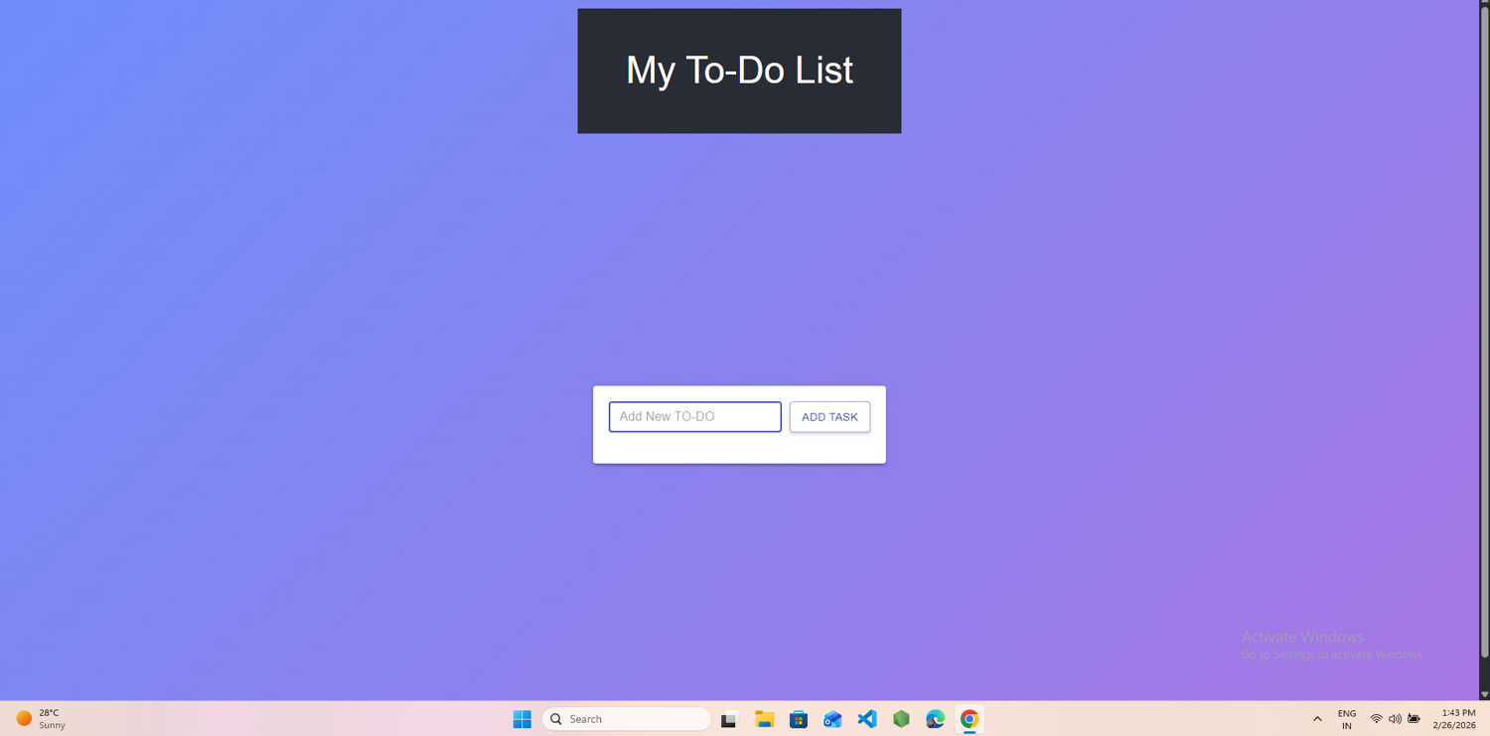
Screenshot 1: To-Do List App interface (Add Task)

Slide 7
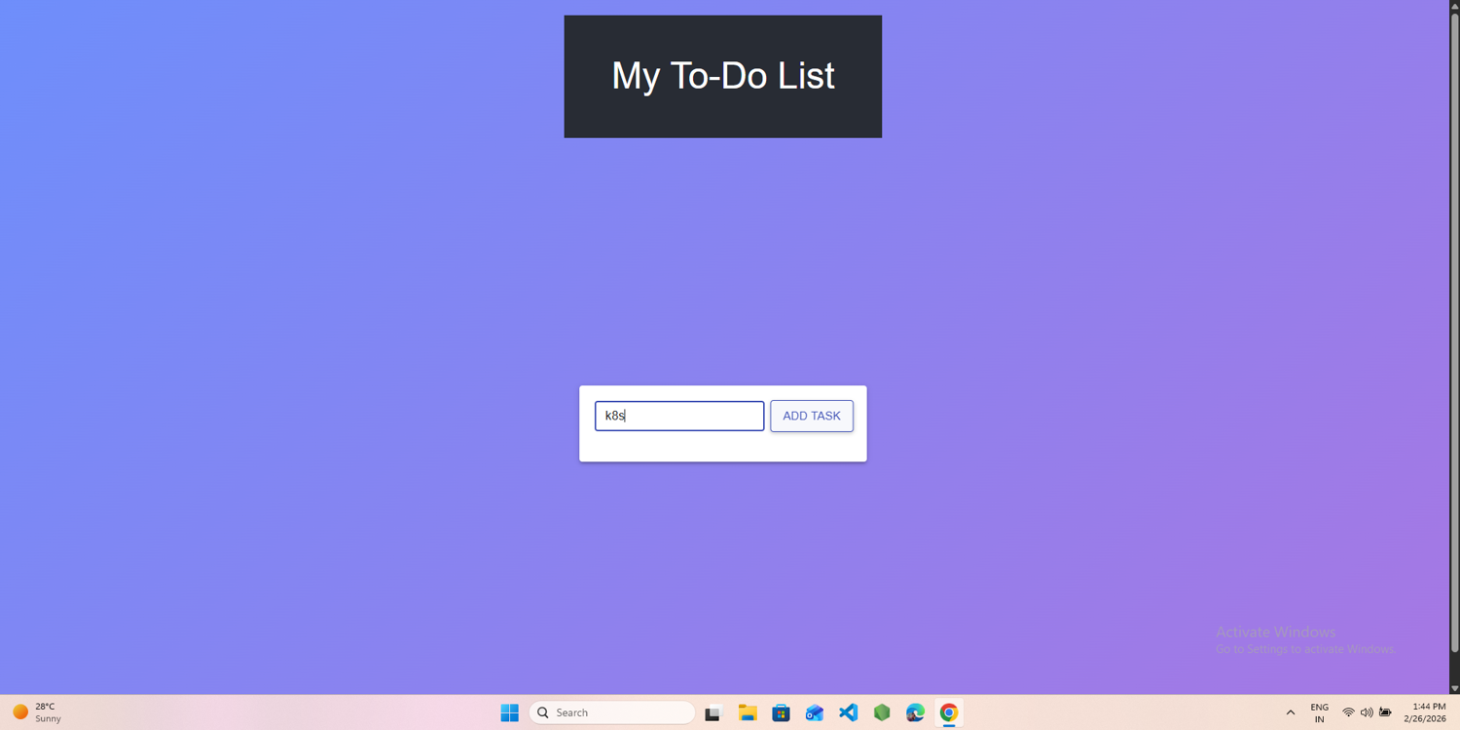
Screenshot 2: Added 1 task

Slide 8
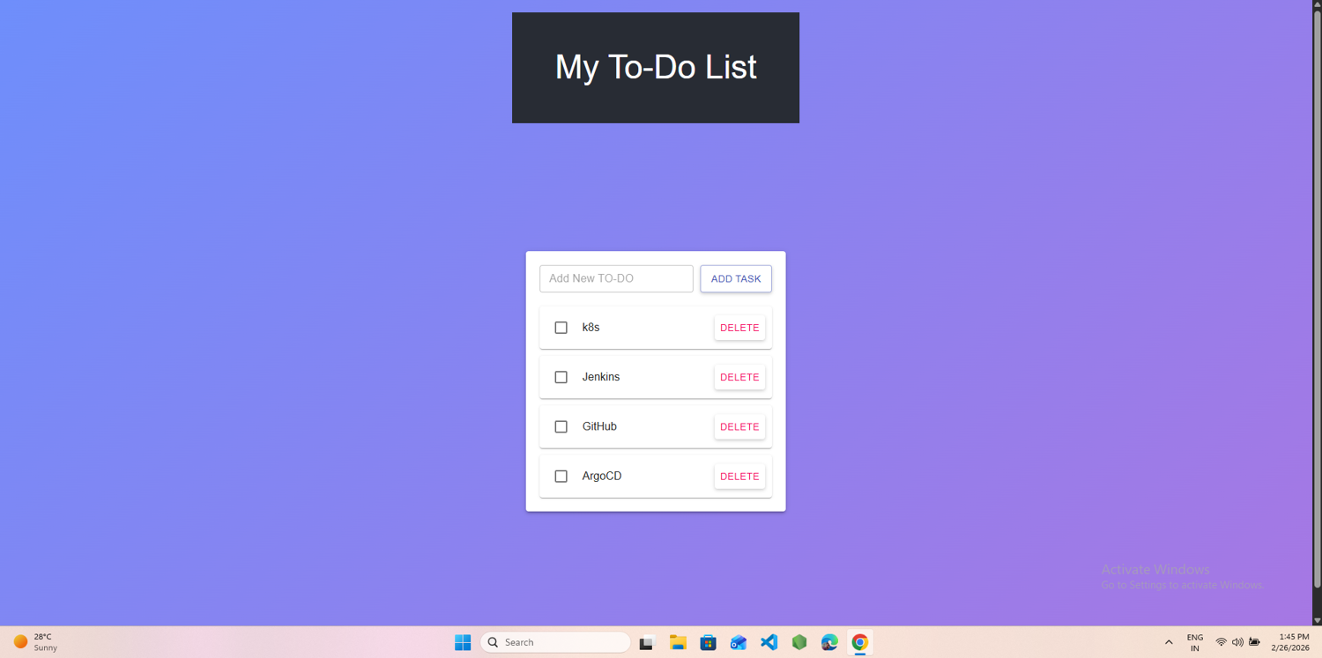
Screenshot 2: Tasks added (k8s, Jenkins, GitHub, ArgoCD)

Slide 9
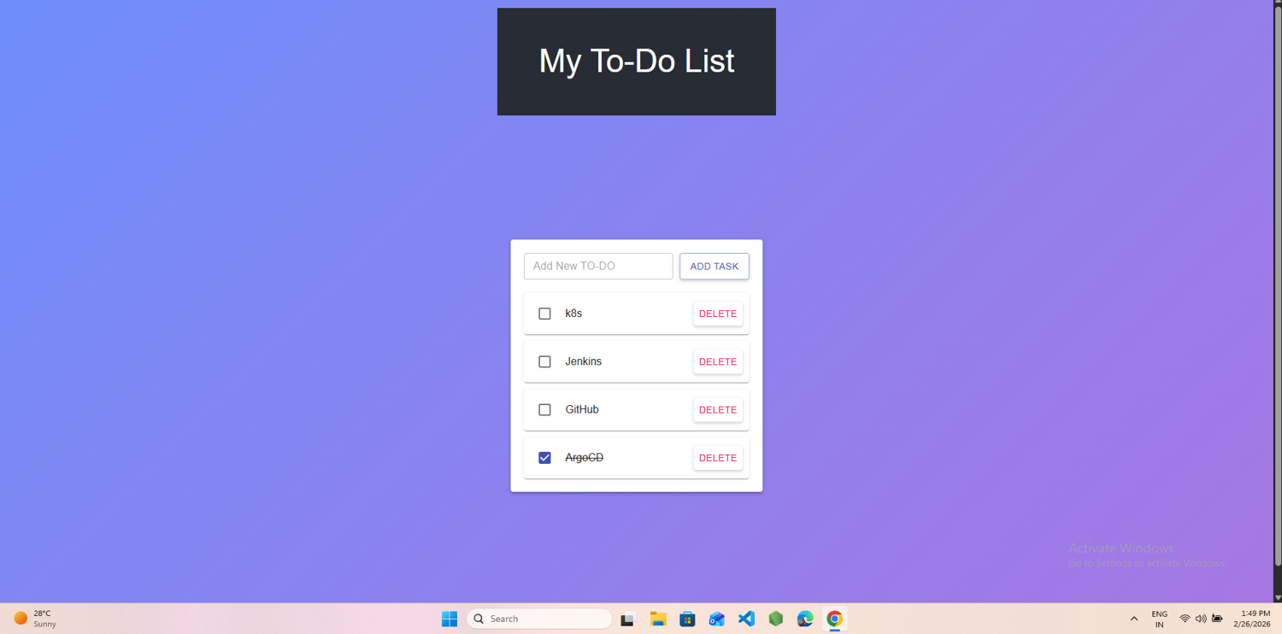
Screenshot 3: Task marked completed

Slide 10
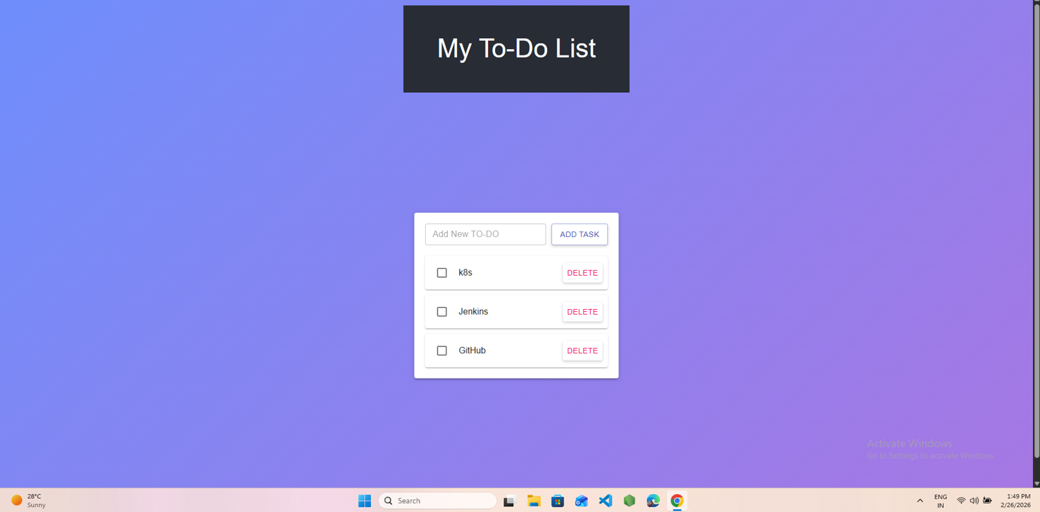
Screenshot 4: Task deleted

Slide 11
Verification
Cluster nodes running: kubectl get nodes
Load Balancer Controller deployed: kubectl get deployment -n kube-system
Application accessible via Load Balance

Slide 12
Cleanup
Deleted EKS Cluster
Terminated EC2 instance
Removed Load Balancer & security groups
Deleted IAM policy
Animation: Items Disappear one by one

Slide 13
Conclusion
Successfully deployed a three-tier application on AWS EKS
Integrated with AWS Load Balancer Controller
Verified with live project output (To-Do List App)
Repository includes: README, Code, PPT with screenshots

Slide 14
